Slide 1

January 26, 2025
For HIRE
Energy AI HACKATHON 2025
noe davila-vega — Computer Science
nurali bibolat — Department of Physics
Lisa byeon — McCombs School of Business
Denys osmak — Department of Statistics and Data Science
artem Shevchenko — Hildebrand Department of Petroleum and Geosystems Engineering

Slide 2
Optimize stage count and timing based on formation characteristics
January 26, 2025
Problem
Hydraulic fracturing is considered the standard for developing new oil and natural gas wells in the United States, but it requires an enormous amount of energy.
For HIRE
Energy AI HACKATHON 2025
Solution
We developed a Learning Model workflow to estimate the energy use for a prospective well and energy source.
Executive Summary
Insights
Fuel type selection impacts use significantly
Formation type impacts energy requirements
Fleet type and configuration affect efficiency oil and gas
Recommendations
Optimize stage count and timing based on formation characteristics
Consider grid power where available
Increase training set size to model shortcomings.

Slide 3
Problem Understanding
Uncertainty Analysis
Review documentation
Model Development
Feature Engineering
Residual Calculations
Data Preprocessing
Learning Model Selection
Define objectives
Research
Missing Value Substitution
Realization Value Reconstruction
Process test data
Model Results
Data Postprocessing
Model evaluation
Flow Chart

Slide 4
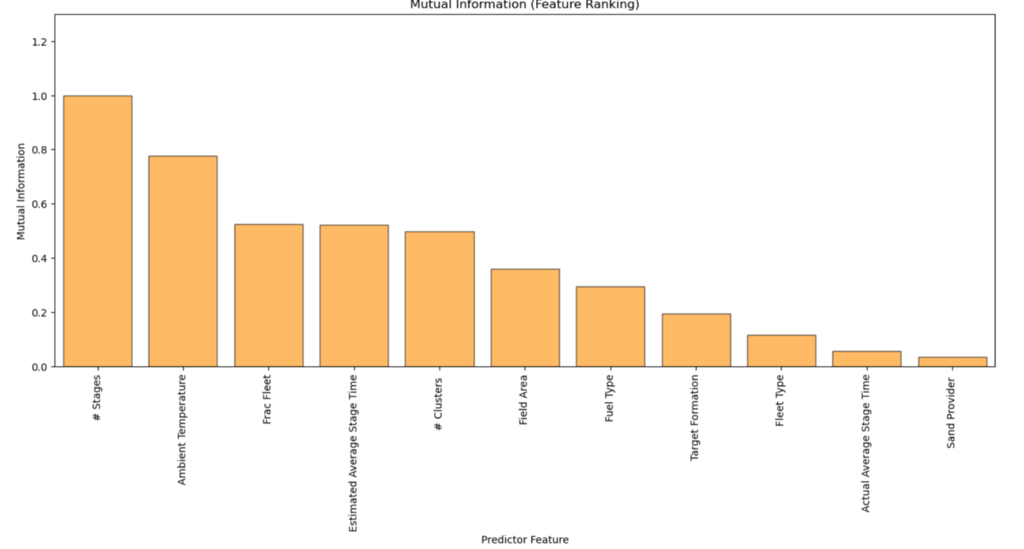
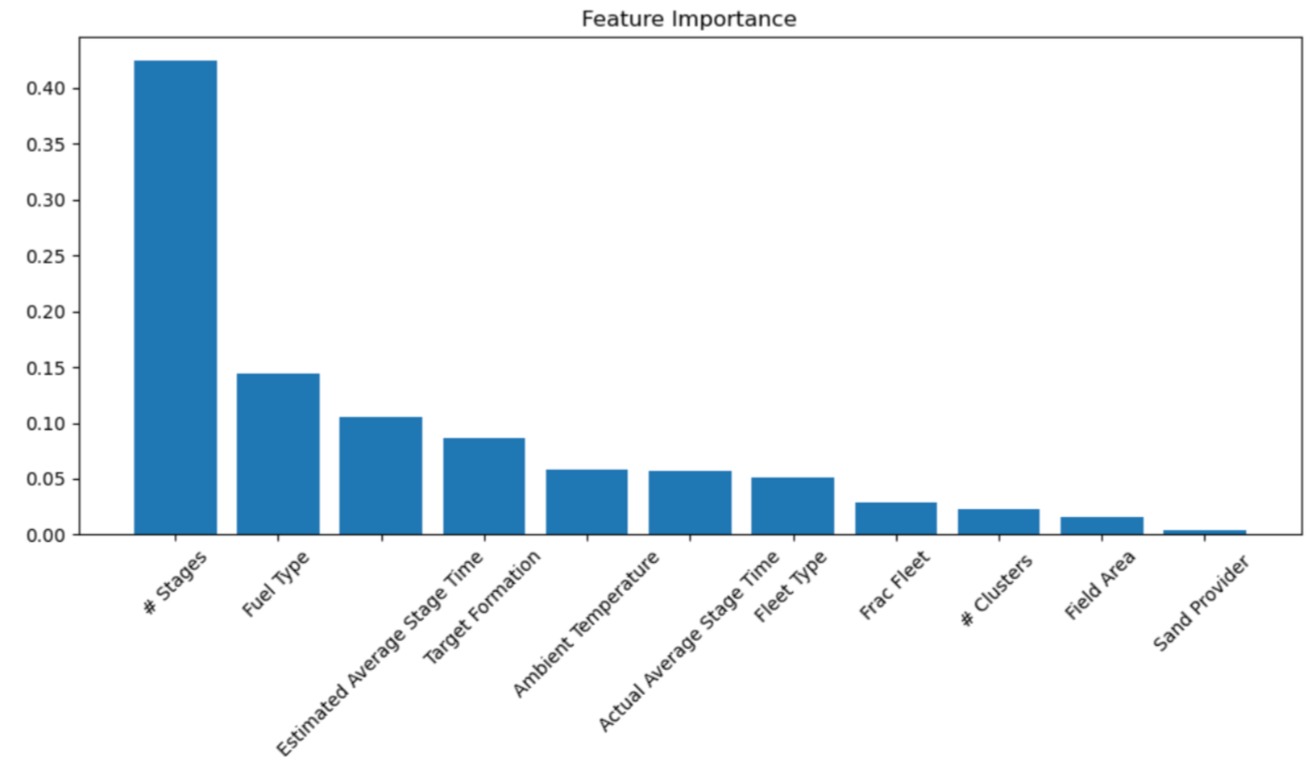
Feature Engineering

Slide 5
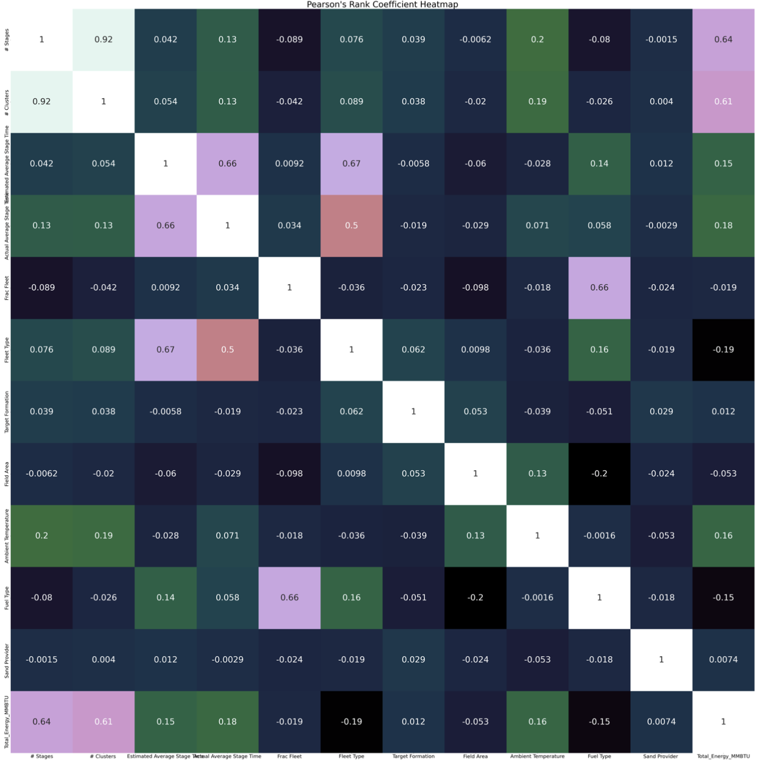

Slide 6
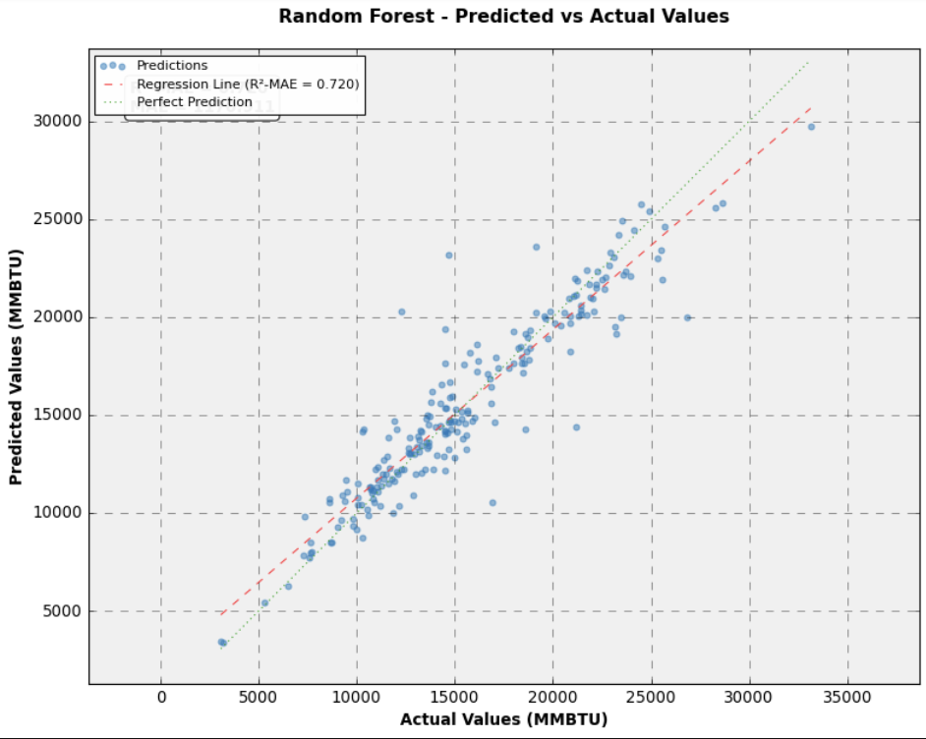
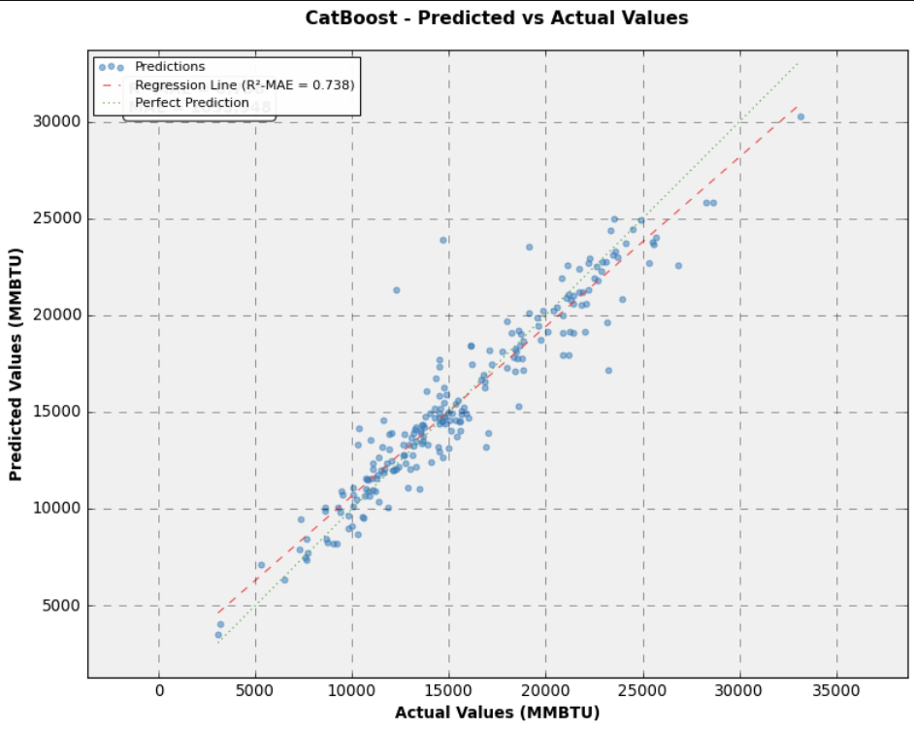
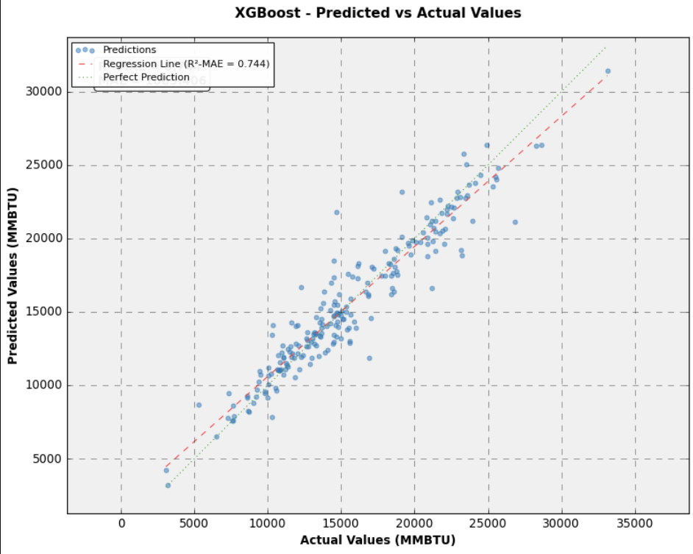
Predictions (Mean Absolute Error)

Slide 7
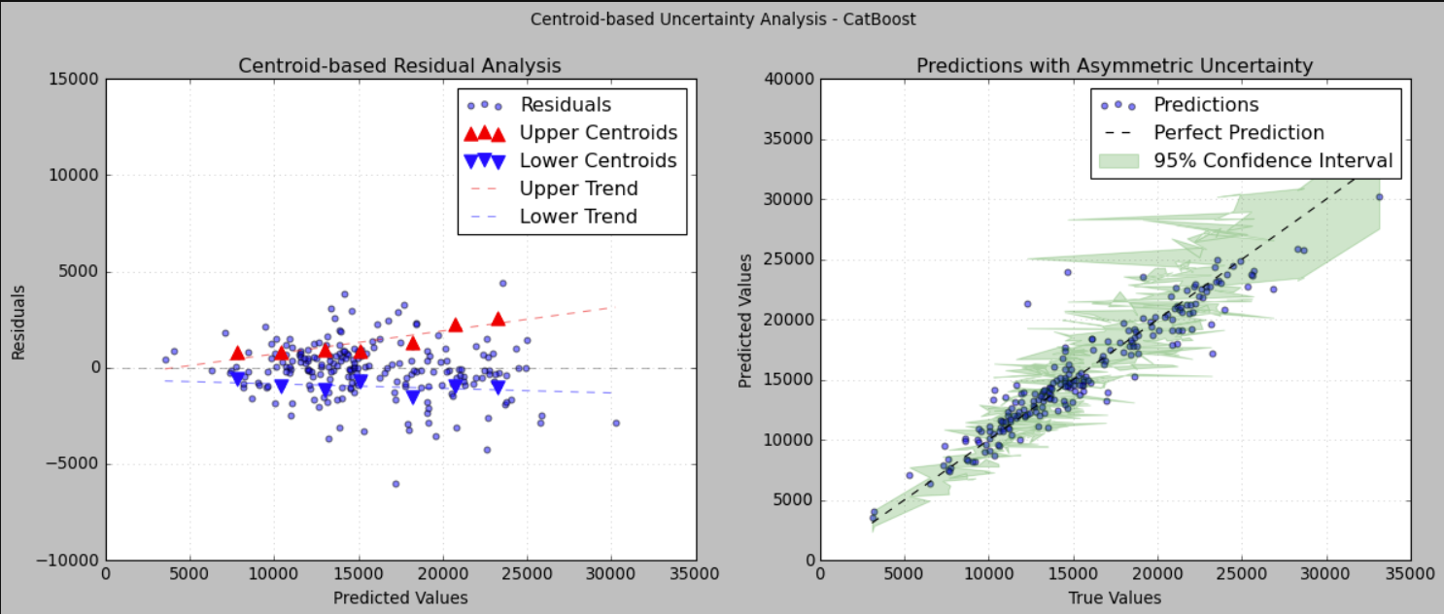
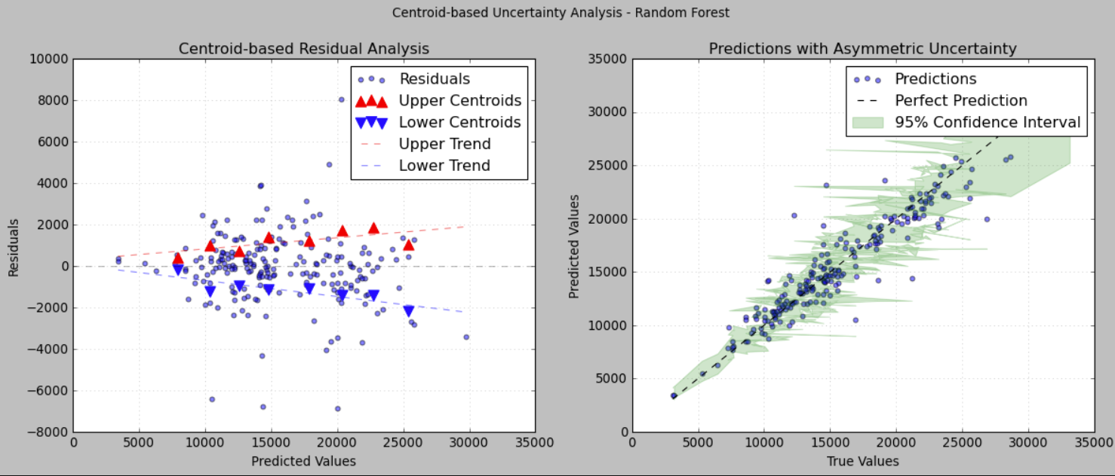
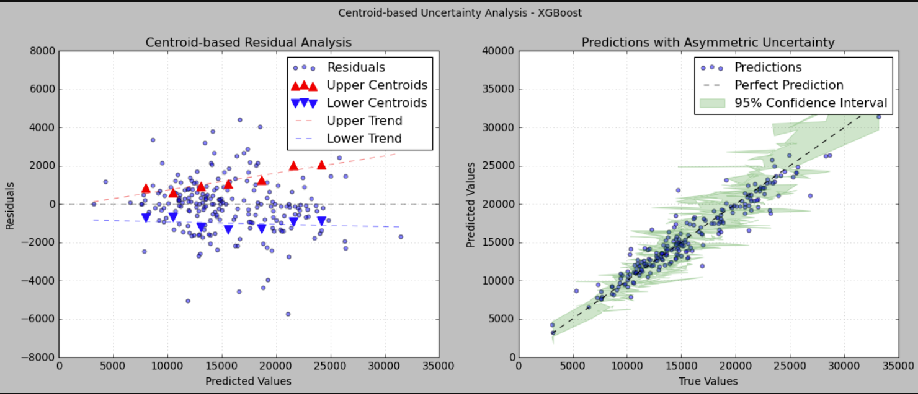
Proportional Effect

Slide 8
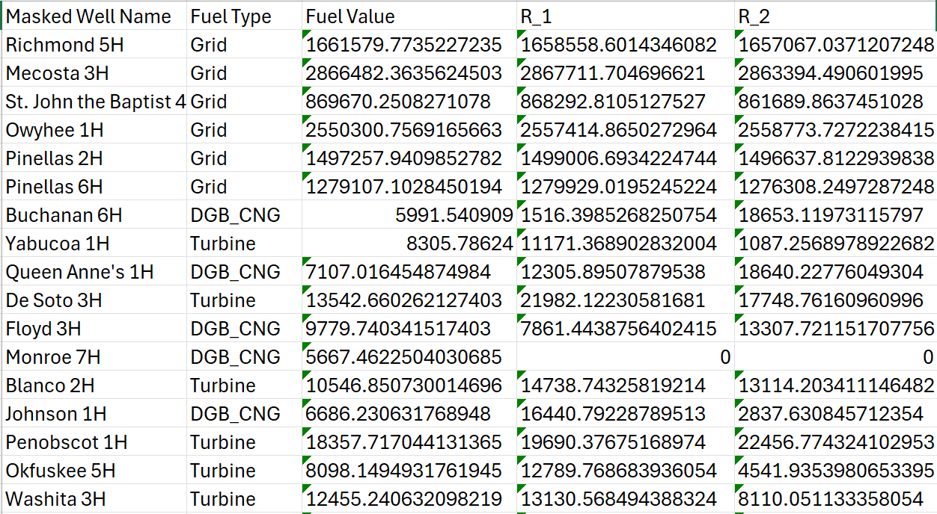
Results

Slide 9
Consider grid power where available
Feedback
What did your team learn?
Petroleum and geosystem engineers are involved in a surprising amount of data science during operations! Implementing uncertainty quantification using the Proportional Effect Principle and other advanced Data Science methods.
What did your team like?
Making improvements in performance of the model and seeing how the outputs work. Interdisciplinary interaction and modality.
What could we do to improve next year?
Cake could be an amazing end to our event!

